Slide 1



Developing a model system using Azotobacter vinelandii to investigate the evolution of nitrogen fixation
Brooke Carruthers
Dr. Betül Kaçar, Dr. Amanda K Garcia
AZ NASA Space Grant Symposium 04/17/21

Slide 2
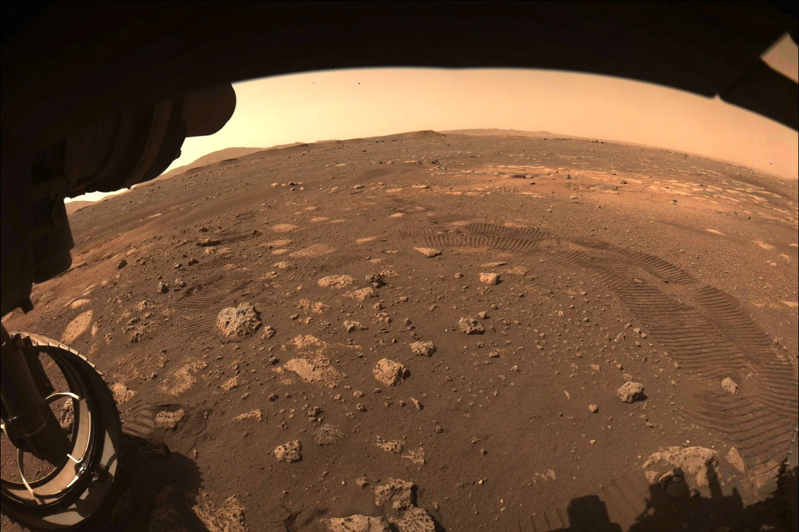
Astrobiology & The Search for Biosignatures
N₂

Slide 3
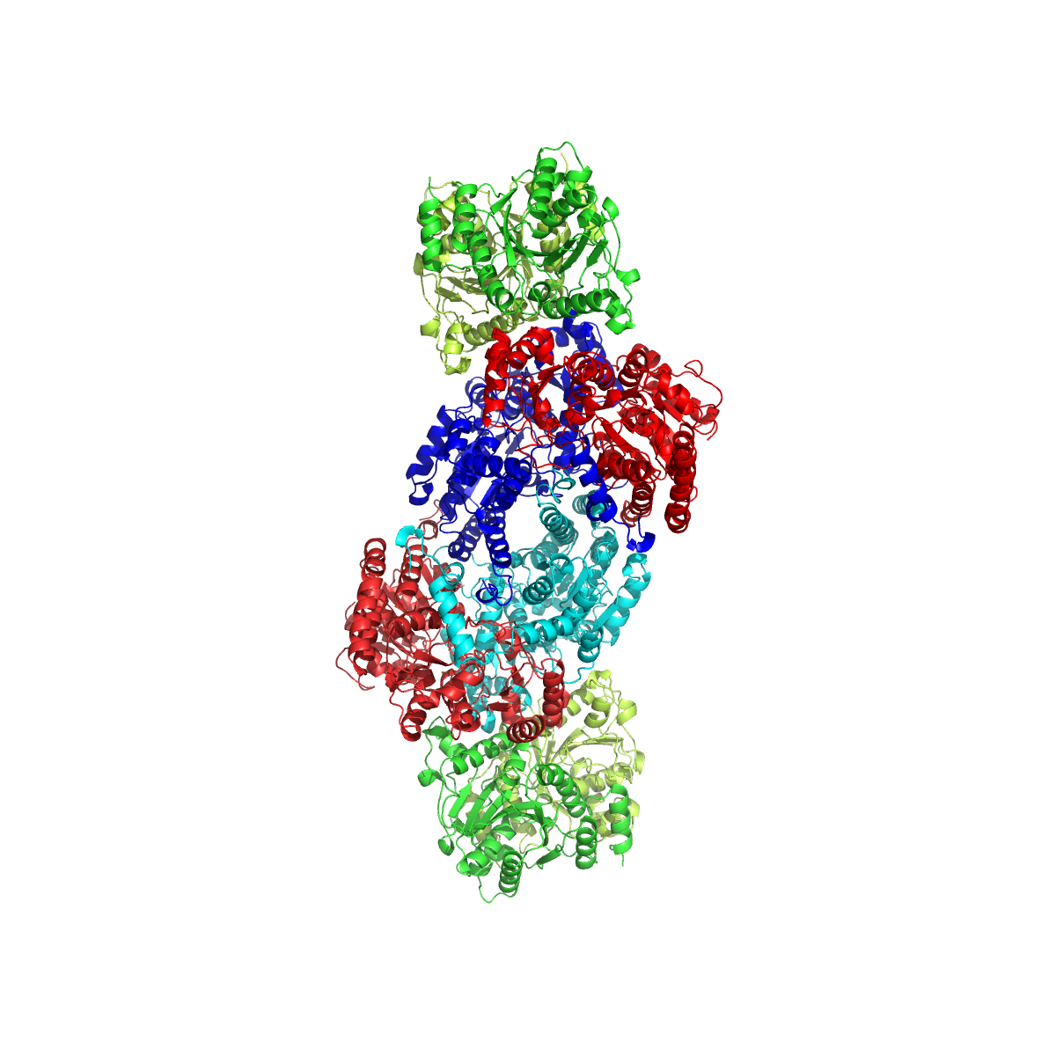
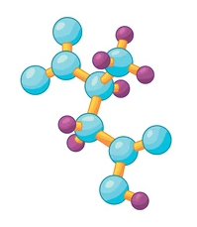

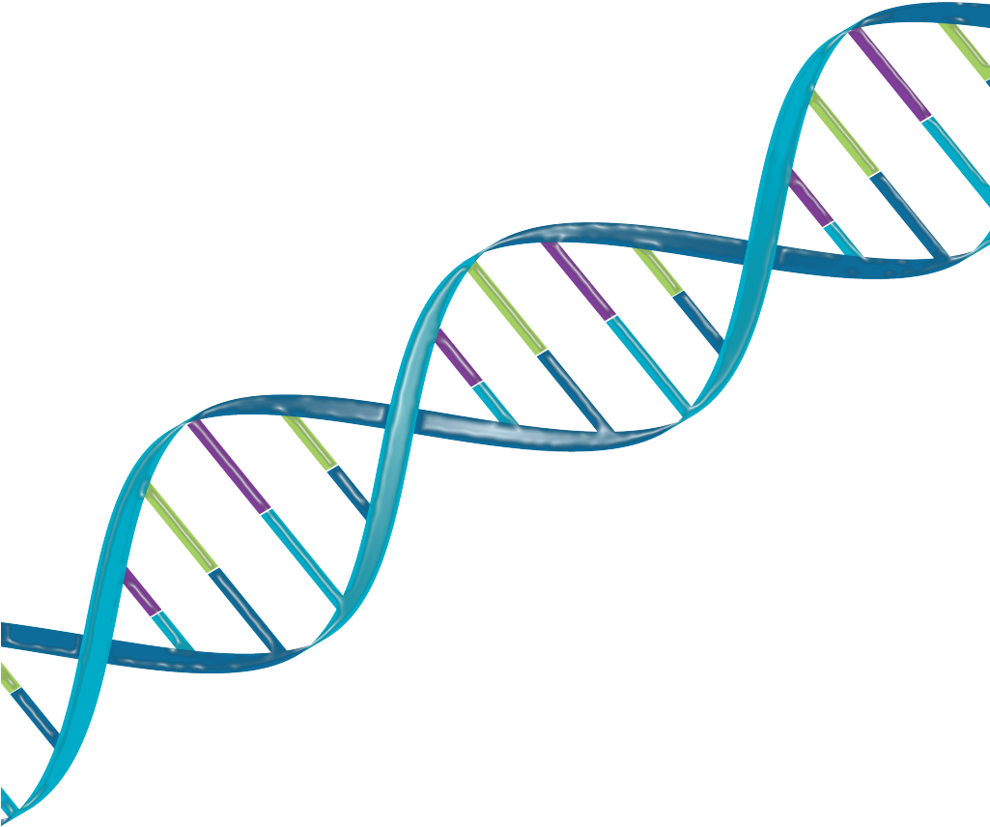
Nitrogen fixation
is an ancient and essential process for life on Earth
N₂(g)
Biological N-fixation
NH₃
Makes N available to life
Mediator between biotic and abiotic
Evolution of N-fixation transformed the planet and life on Earth
Nitrogenase enzyme

Slide 4

How did early life fix nitrogen in an early Earth environment?
What biosignatures did this produce?

Slide 5
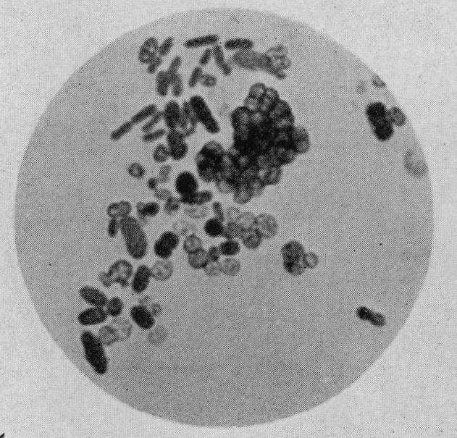
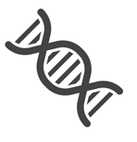

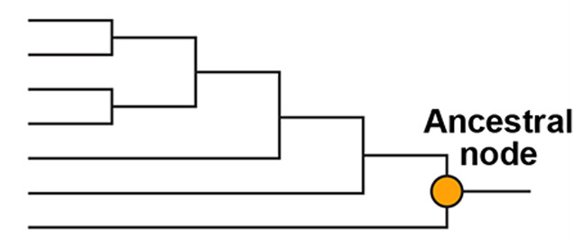
A new approach to study ancient life
Engineer ancestral genes in modern microbes so they behave like ancient life
Inferred sequence coding for an ancestral enzyme is synthesized
Genetic Engineering
Model Organism: Azotobacter vinelandii
(Nitrogen-fixing)

Slide 6
A. vinelandii needs nitrogenase to grow diazotrophically = growth without available fixed nitrogen
  Therefore, observed growth under diazotrophic conditions reflects nitrogenase activity
Need a laboratory growth protocol . . .

Slide 7
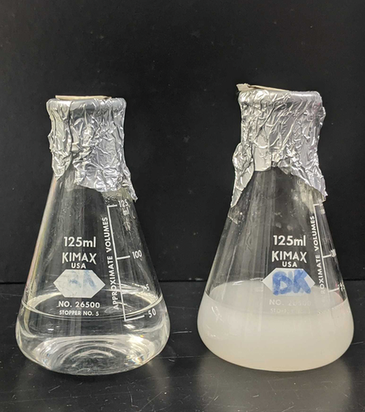
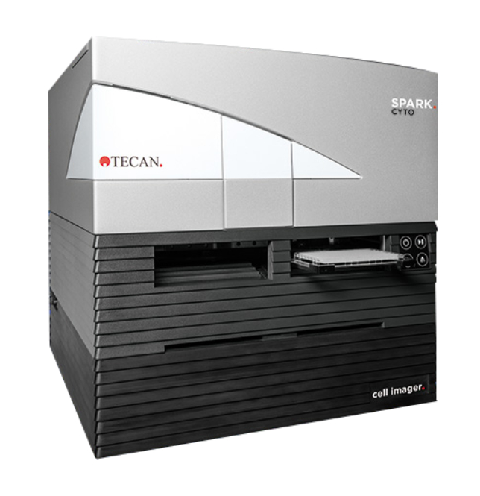
We developed an automated growth protocol for A. vinelandii
Variables to optimize:
Volume
Temperature
Plate reader settings
Growth time
Carruthers et. al, Current Protocols (2021)
Used a plate reader to take optical density measurements to measure changing cell concentration
More efficient, more replicable, less manual labor
Optimized growth parameters and conditions

Slide 8
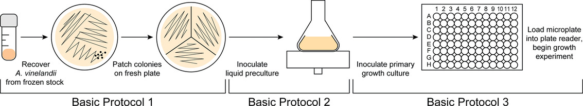
Our overall procedure assesses growth under diazotrophic conditions
Contains N
N-free
First grow all strains on plates with N-containing media
Then inoculate in N-free liquid medium and monitor diazotrophic growth in the plate reader

Slide 9
A. vinelandii can be reliably grown in a plate reader with high replicability
Produce growth curves for computational analysis of growth rate and other parameters
Reflects N-fixing efficiency of modified nitrogenases
Adapted from Carruthers et. al, Current Protocols (2021)

Slide 10
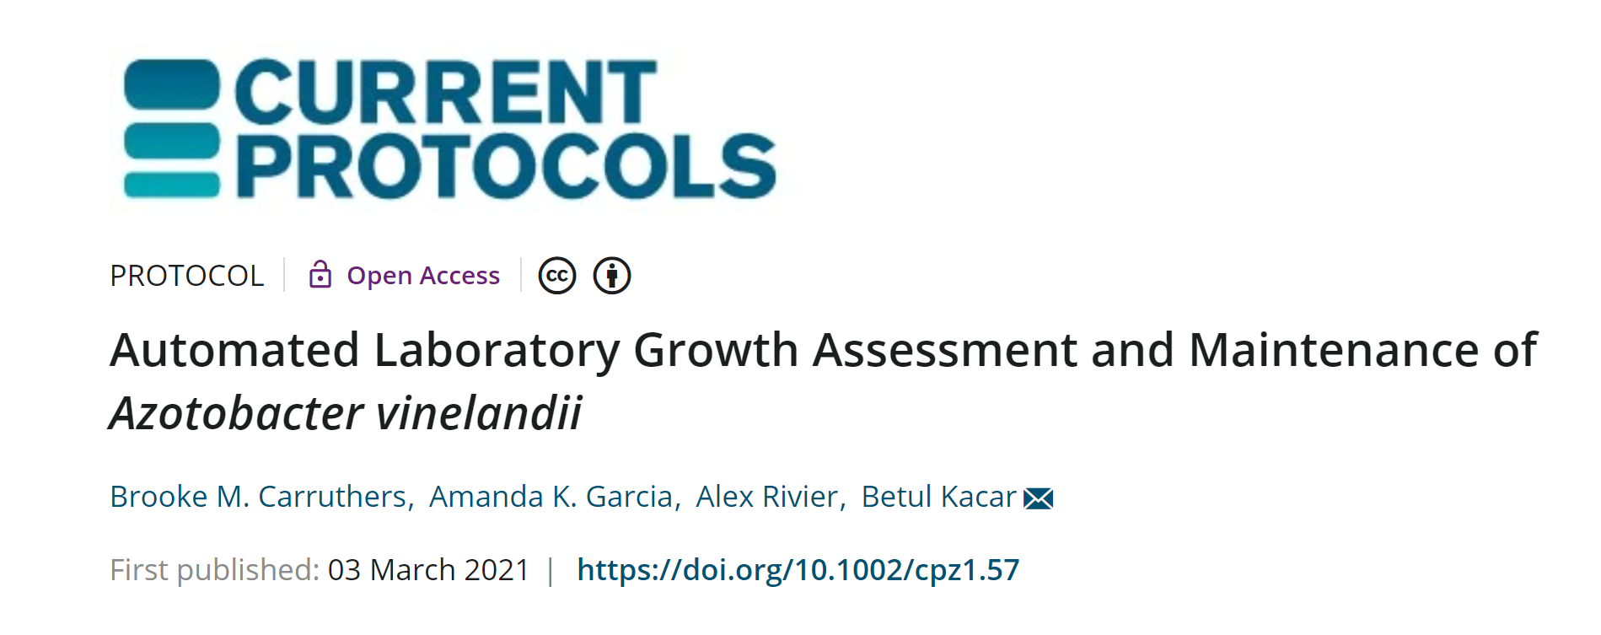

Slide 11


Next steps
We can infer ancestral nitrogenases and engineer them in modern microbes
We now have a protocol to assess the ancestral enzyme activity
Next = Implement growth protocol to study ancestral nitrogenases

Slide 12
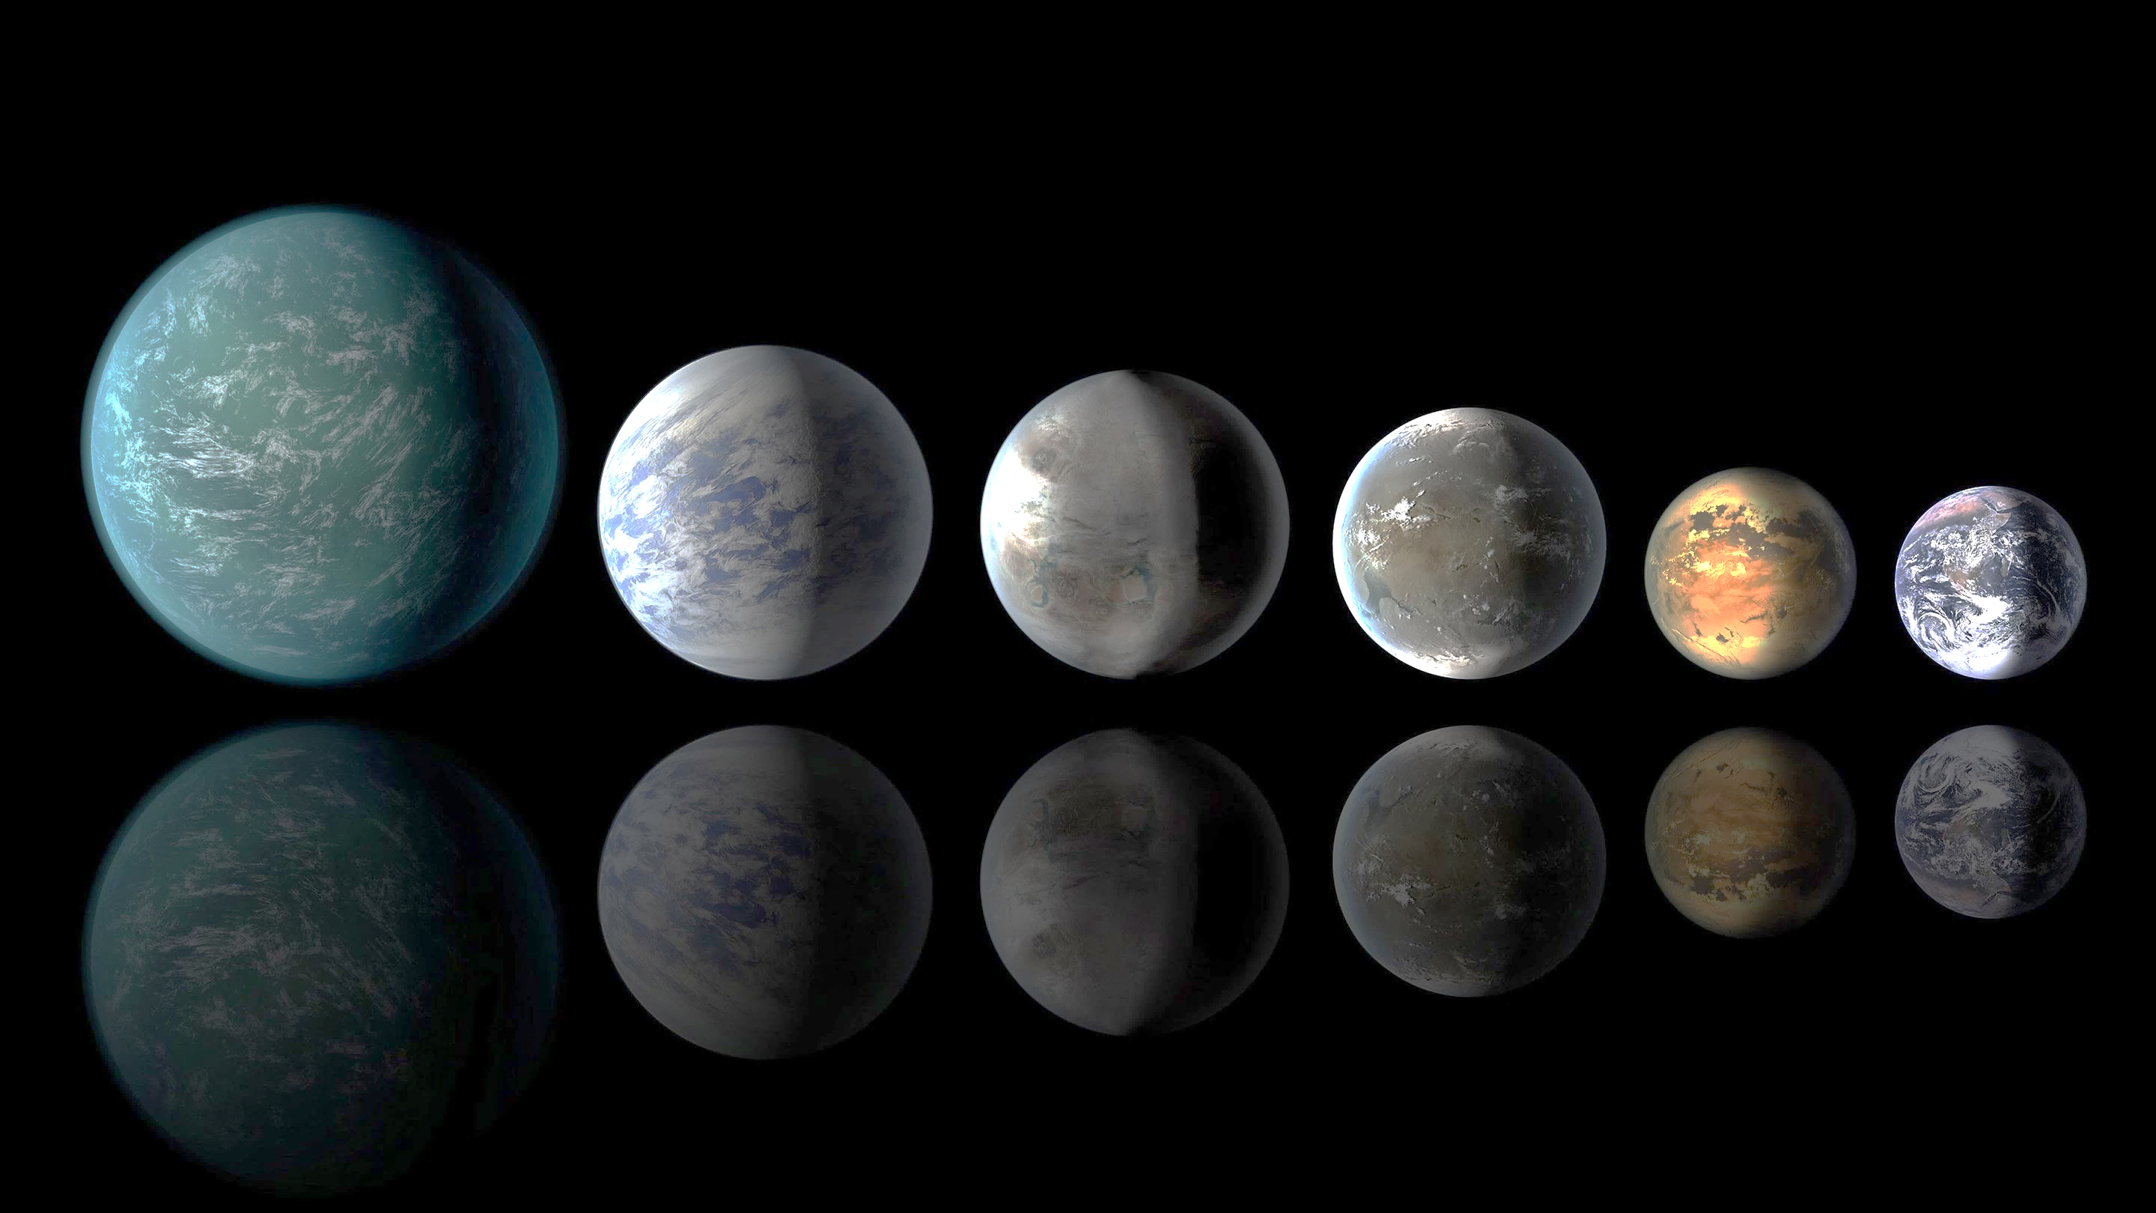
Investigations of ancestral nitrogenases can inform our understanding of early Earth and of nitrogen cycling on other extraterrestrial bodies.

Slide 13
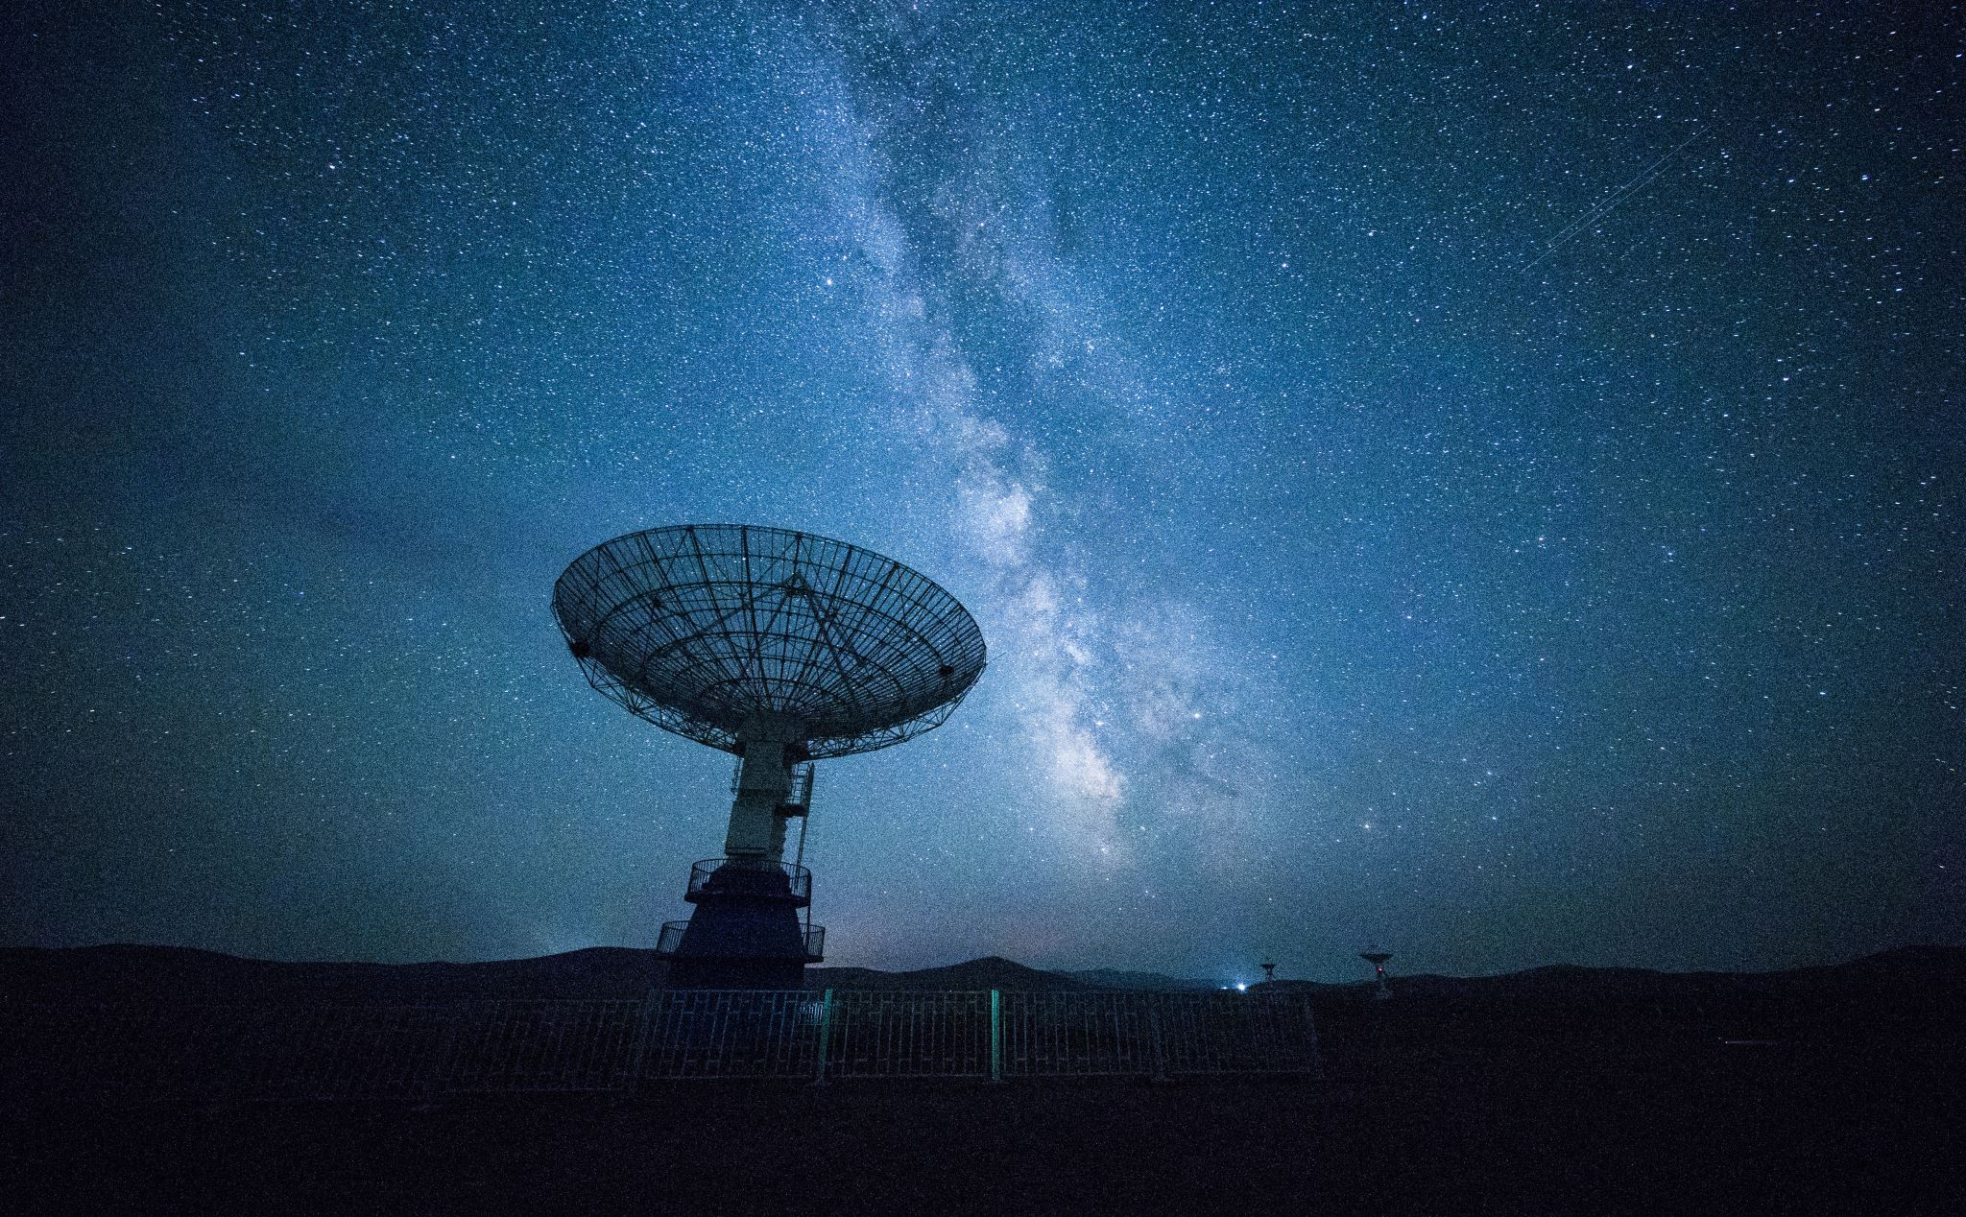
Acknowledgements
NASA Space Grant Consortium
Betül Kaçar
Amanda Garcia
Alex Rivier
Kaçar Lab team

Slide 14
Thank You!
Questions?

